Slide 1





Scalable Mapping of Clinical Notes to LOINC Document Ontology via Bag of Words
A Greater Plains Collaborative (GPC) Effort
University of Missouri, Columbia (MU)
Medical College of Wisconsin, Milwaukee (MCW)
Dave Bell
Kristen Osinski
Alex Stoddard
Brad Taylor
Huzaifa Khan
Vyshnavi Paka
Abu Saleh Mohammad Mosa
Lemuel R. Waitman
October 19th , 2023

Slide 2
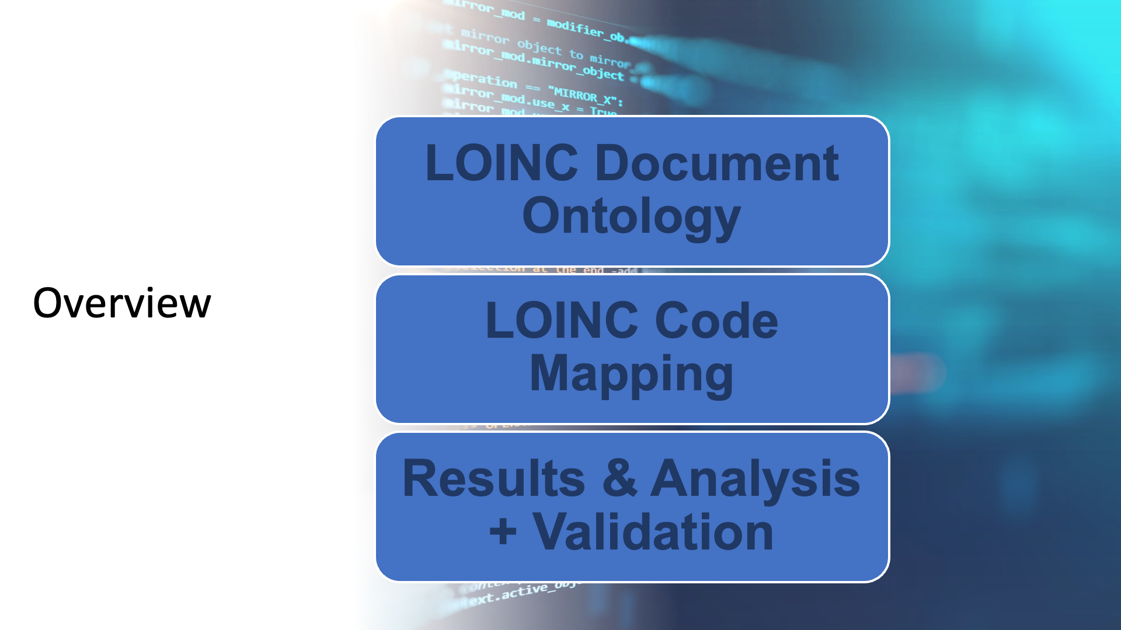

Slide 3
LOINC Document Ontology (DO)

Slide 4

Logical Observation Identifiers, Names, and Codes
Our goal: assign a LOINC Code to all clinical documents
Ease of organization
Gives a broad view of the content
Makes documents Query-able
Documents are assigned LOINC Codes based on FIVE Dimensions
Each dimension requires a Part Number and a Part Name
It is not necessary for every LOINC Coded document to have all FIVE dimensions mapped

Slide 5
Document Ontology Dimensions
Subject Matter Domain (SMD)
Dentistry, Allergy, etc…
Kind of Document (KOD)
Note, Report, Prescription list, etc…
Type of Service (TOS)
Consultation, Procedure, Counseling, etc…
Setting
Outpatient, Telehealth, Pharmacy, etc…
Role
Patient, Nurse, Physician, etc…
Examples
68478-7: Pulmonary Attending Hospital Progress Note
97711-6: Heart failure Outpatient Note
34112-3: Hospital Note
PARTNAME | PARTNUMBER
{Role} | LP187187-2
Physician | LP173084-7
Attending | LP269965-2
Social worker | LP269801-9
Consultant | LP269966-0
Nurse | LP173075-5
Medical student | LP173092-0
Hygienist | LP173071-4
Interdisciplinary | LP173072-2
Patient | LP173083-9
Pharmacist | LP181523-4
Licensed practical nurse | LP173081-3
Resident | LP269969-4
Team | LP173073-0
Rapid response team | LP203036-1

Slide 6
Manual Value-Set Mapping
Subject Matter Domain – Note_Title
Mapped 30% of all notes to a SMD
Kind of Document – Note_Type
Mapped 50% of all notes to a KOD
Type of Service – Event_Description
Mapped 40% of all notes to a TOS
Setting – Encounter_Type
Mapped 80% of all notes to a Setting
Role – Encounter_Note_Author
Mapped 35% of all notes to a Role
Result: only around 25% of notes were mapped with Valid LOINC Code
Programmatic Mapping
Will give us more coverage
Will be repeatable and extensible
Bag of Words
Number of Parts | Number of Documents | % values
0 | 7,225,678 | 5%
1 | 25,015,785 | 19%
2 | 41,216,686 | 31%
3 | 33,005,516 | 25%
4 | 21,267,870 | 16%
5 | 4,899,873 | 4%
Total | 132,631,408

Slide 7
Bag of Words Mapping Implementation

Slide 8

Pipeline Overview
Summary
After Data staging and gather clinical notes, Metadata needs to be consolidated
Grouping by Metadata should significantly reduce size of unique rows
Program takes metadata and further reduces the unique rows by removing unhelpful keywords
Results in a fraction of original problem space
Data Consolidation Step
In-program Step
Complete Table of all Clinical Documents
Remove irrelevant words from columns to decrease unique combinations
EX.
Doctor is prescribing a medicine A
Doctor is prescribing a medicine B
Doctor is prescribing a medicine C
Doctor, prescribing, medicine
Distinct rows grouped by columns containing relevant data
Unique Rows of Metadata terms useful for LOINC Mapping

Slide 9
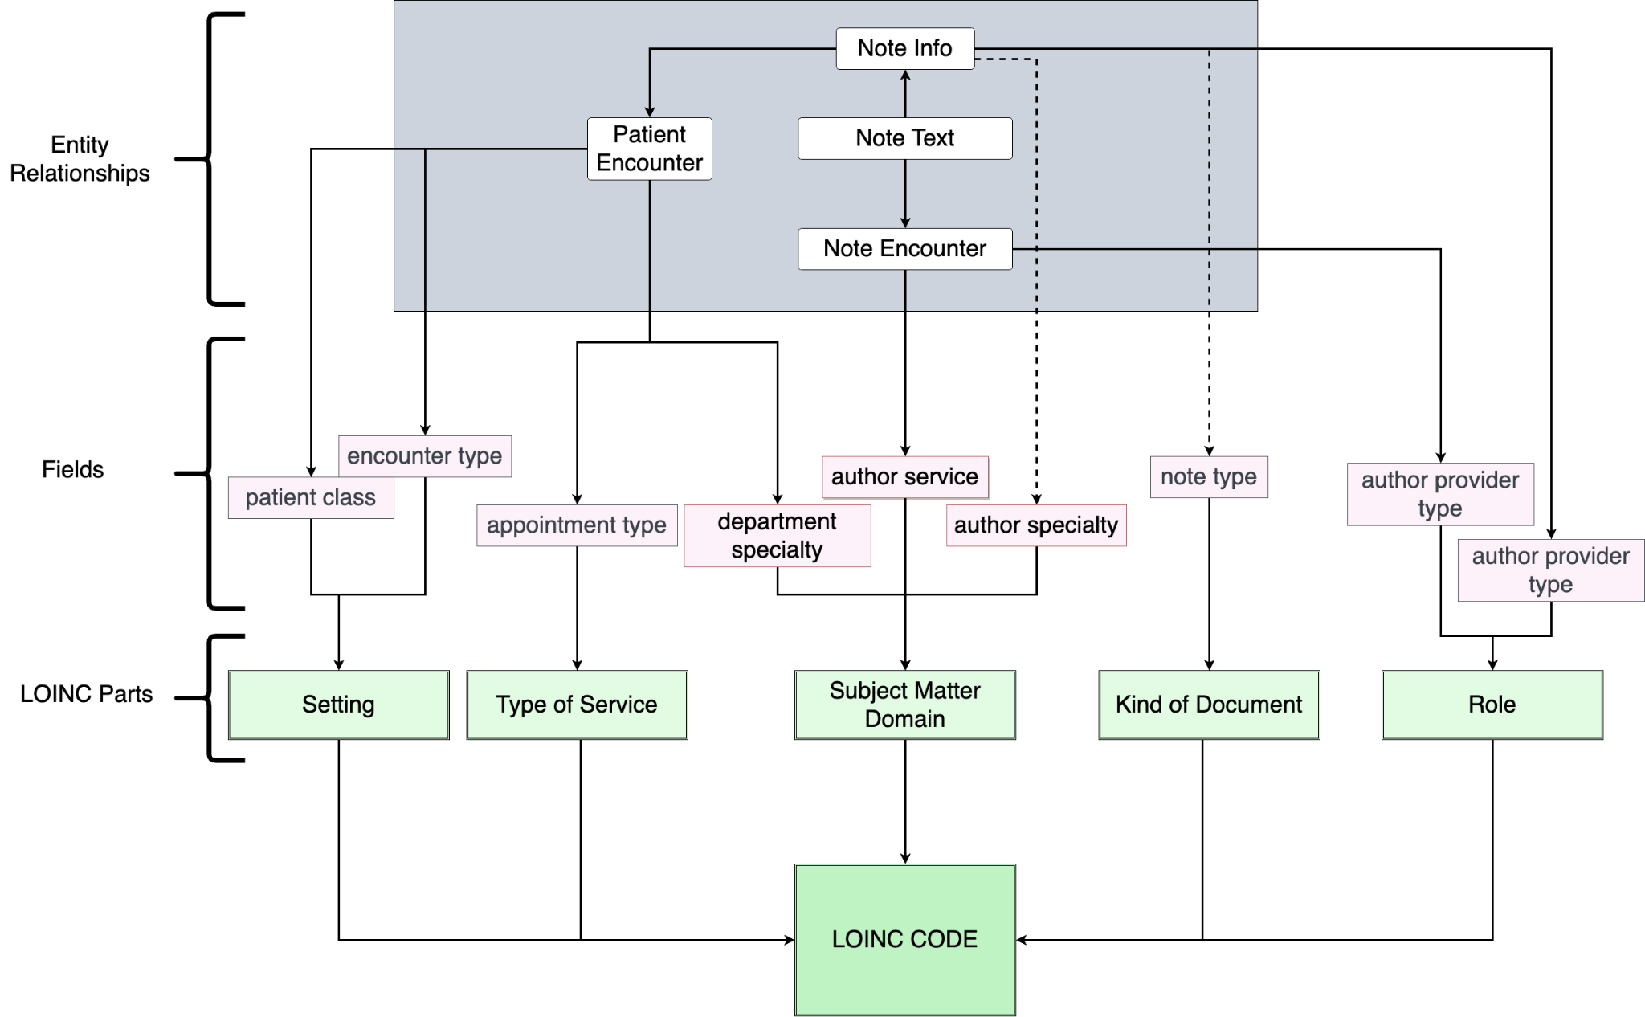
LOINC Mapping Diagram
Summary
This diagram visualizes the columns used for the LOINC Mapping
Multiple sources are used for domains
Actual column names may differ depending on your site’s EHR vendor

Slide 10
Data Table Preparation
Original Table
MU
132.6 Million notes.
289,000 Rows distinct metadata sets
MCW
193.8 Million notes
267,151 Rows distinct metadata sets
The program will operate on the significantly smaller Intermediary Table and join back to the individual notes at the end
Intermediary table of Distinct Values
A | B | C | D | E | F
** | ** | ** | ** | ** | **
** |  | ** | ** | ** | **
** | *** |  |  |  | **
** | ** | ** | ** | ** | **
** | ** | ** | ** |  | **
** | *** | ** | ** | * | **
** | *** | ** |  | ** | **
** | *** | ** |  | * | **
** | ** | ** | *** | ** | **
B | D | ID
** | ** | 1
 | ** | 2
*** |  | 3
*** | ** | 4
** | *** | 5

Slide 11
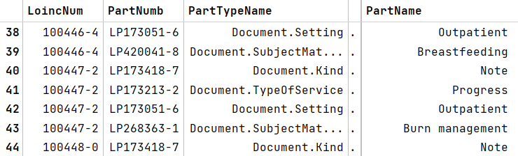
Bag of Words Generation
LOINC Code Bag of Words
Example code 100447-2 has 4 Part Numbers, each represented by a row
{“note”, “progress”, “outpatient”, “burn”, “management”}
Metadata Bag of Words
{“registered”, “nurse”, “internal”, “medicine”, “refill”, “telephone”, “encounter”}
Role | SMD | TOS | Setting | KOD
Registered Nurse | Internal Medicine | Registered Nurse | Refill | Telephone Encounter

Slide 12
Bag of Words (BOW) Example
1. Document Metadata
ED Patient Depart Summary, University Hospital, Care Delivery, UH Emergency
Mapping Summary
Word order is lost in BOW
“{role}” and “{setting}” wildcards are added.
Priority is given to real axis, if available (e.g. Emergency)
Synonymy List
Depart -> Discharge
Summary -> Note
Chosen LOINC Code is 59258-4
2. BOW
hospital, discharge, care, emergency, summary, delivery, note, patient, {role}, {setting}
LOINC BOWs
3A. 59258-4
Discharge, emergency, summary, note, {role}
3B. 34112-3
hospital, note, {role}
3C. 11506-3
progress, note, {role}, {setting}

Slide 13
Results

Slide 14
Coverage Results
MU
~ 87% of all clinical documents were mapped to LOINC Codes
35% initial coverage and slowly improved using the Synonymy List
MCW
~ 93% of all clinical documents were mapped to LOINC Codes
55% initial coverage and slowly improved using the Synonymy List

Slide 15
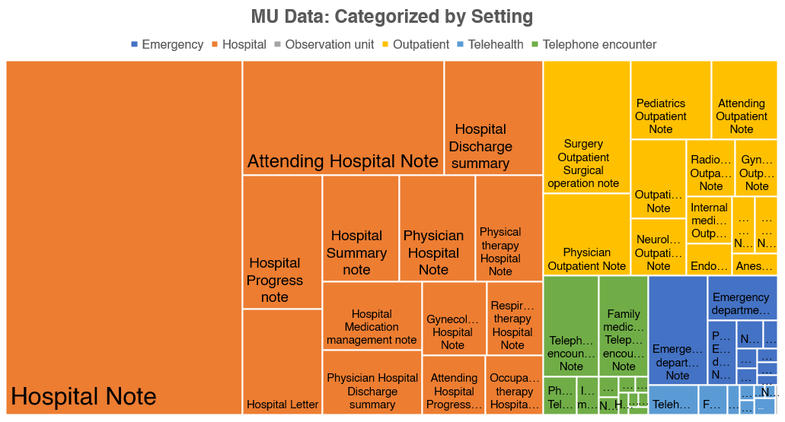
Notes Distribution Based on Setting

Slide 16
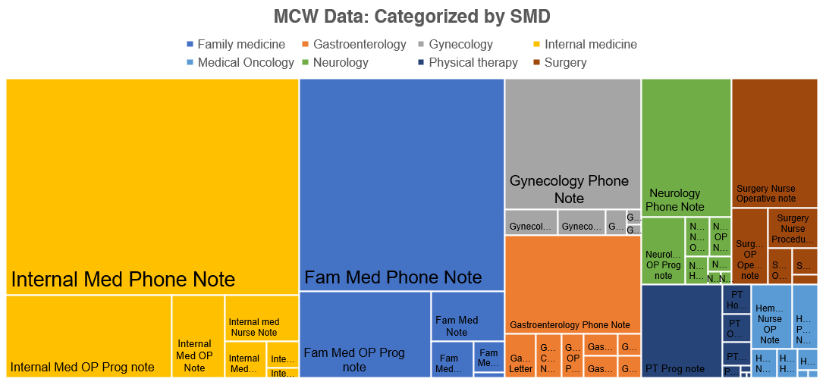
Notes Distribution Based on SMD

Slide 17
SMD Distribution between sites

Slide 18
Validation

Slide 19
Validation
Note Selection
200 rows randomly selected from 1000 most common combinations of metadata
MU:
200 rows or ~15 million notes, ~10% of total
Basic accuracy in terms of note count: ~91%
MCW:
200 rows or ~25 million notes, ~8% of total
Basic accuracy in terms of note count: ~85%
Row Count | Valid | Invalid
MU | 167 (83.5%) | 33
MCW | 157 (78.5%) | 43
Note Count | Valid | Invalid
MU | 13.93 M (91%) | 1.27M
MCW | 21.78 M (85%) | 3.91M

Slide 20
Validation
Iterative Mapping Improvements (From MCW Notes)
Initial validation highlighted issues:
Undesirable document types
“scanned documents”
Missing synonym list entries
“OB/GYN” -> “Obstetrics & Gynecology”
Some phrases cause consistent, incorrect labelling
“surgery” -> “operative note”
Row Count | Valid | Invalid
Round 1 | 116 (58%) | 84
Round 2 | 138 (69%) | 62
Round 3 | 157 (78.5%) | 43
role | SMD | TOS | setting | KOD | bow | loinc name
Registered Nurse | Transplant Surgery |  | Telephone | Telephone Encounter | encounter registered {role} {setting} note surgery nurse transplant telephone | Surgery OP Operative note

Slide 21
Closing Remarks
Future Work
Synonymy list sharing issues
UMLS Integration
Mapping to multiple LOINC codes
Testing the framework at different sites may illuminate further flaws to fix
Framework Summary
Made in Python, using the Bag of Words approach
Synonymy list allows ease of improvement of mapping coverage
Lightweight and easily deployable
Efficient and designed with scalability in mind

Slide 22
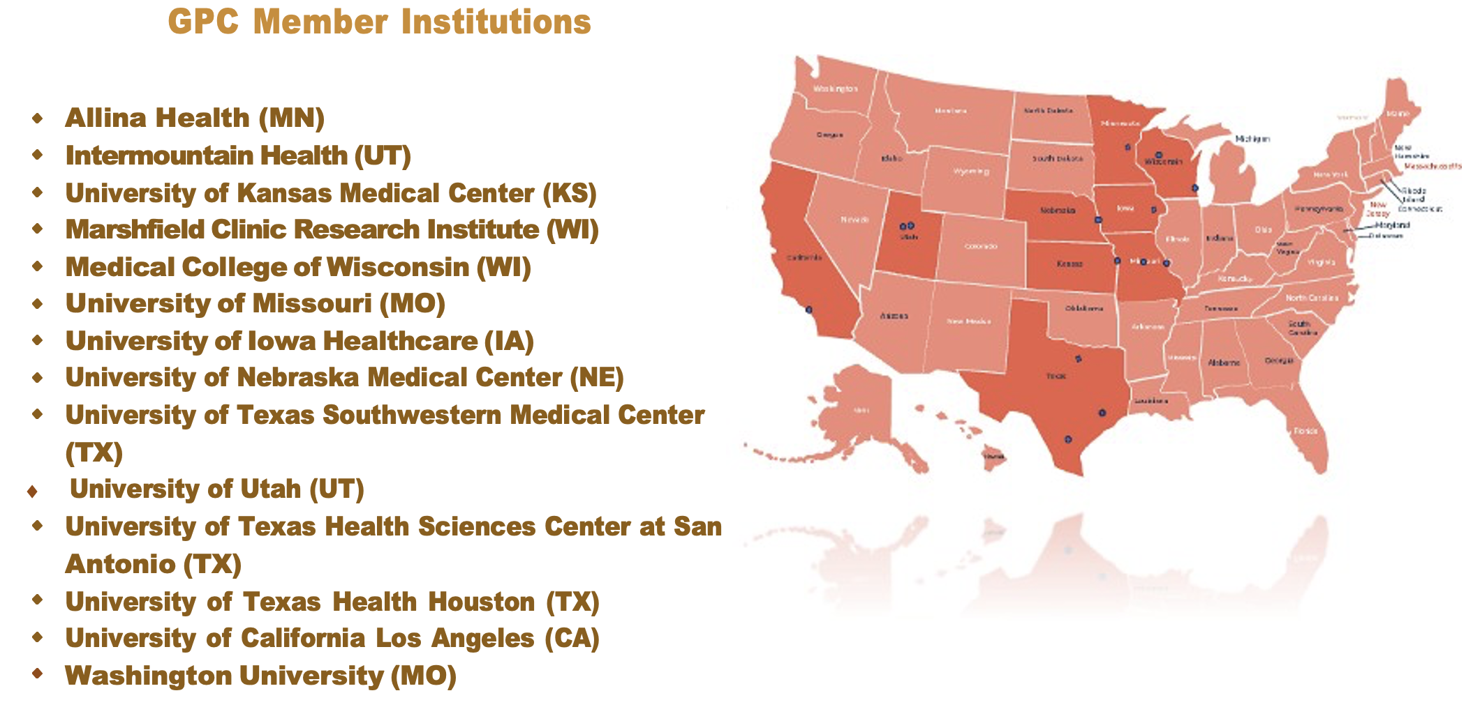
Acknowledgements
Source code is available on GitHub
GitHub Repositories
Public: https://github.com/gpcnetwork/gpc_doc_ontology
Private: https://github.com/gpcnetwork/gpc_document_ontology
GPC Website Info - https://gpcnetwork.org/
Contact
Dave Bell
dabell@mcw.edu
GitHub: dabell4
Huzaifa Khan
hkg8b@umsystem.edu
GitHub: ghkkhan

Slide 23
Questions?

